Slide 1
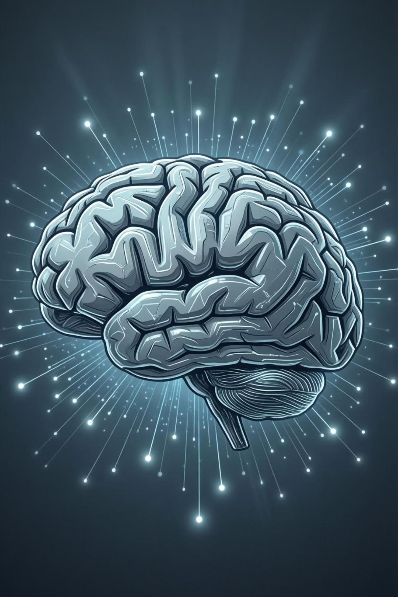
Unlocking the Power of Generative AI
Welcome to our session on Generative AI! Over the next few hours, we'll explore how machines are learning to create, innovate, and transform our world. Get ready to dive into the exciting future of artificial intelligence.

Slide 2

SECTION 1
What is AI & Generative AI?
What is AI?
Generative AI Defined
Artificial Intelligence (AI) is all about teaching machines to think and act like humans. It's the science of making computers capable of learning, understanding, reasoning, and solving problems, just as we do.
Generative AI takes this a step further. Instead of just solving problems, it's designed to create entirely new content across various formats, from text to images, code, and more. It's truly a creative force!
Simulates human intelligence in machines.
Can learn, reason, and solve problems.
AI that creates content: text, images, code, audio, video.
Where do you already see AI creating things in your daily life?

Slide 3


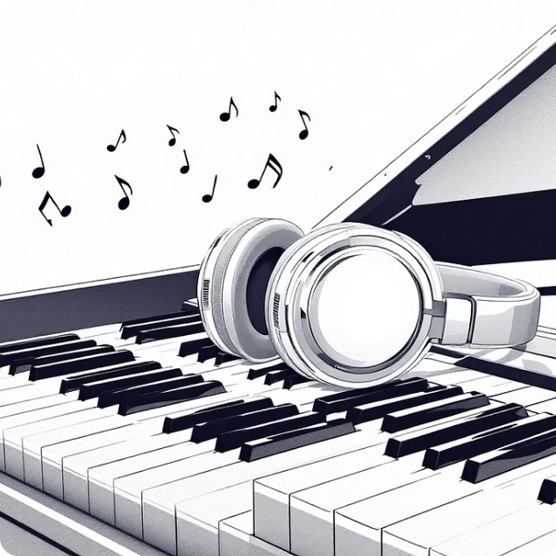
SECTION 1
Generative AI in Your Daily Life
Writing Emails
Creating Images
Composing Music
Tools like ChatGPT can draft professional emails, saving you time and effort.
AI image generators such as DALL·E allow anyone to visualize ideas instantly.
AI can even generate original music, from simple melodies to complex symphonies.
These examples highlight how Generative AI is increasingly becoming a part of our creative and professional lives.

Slide 4
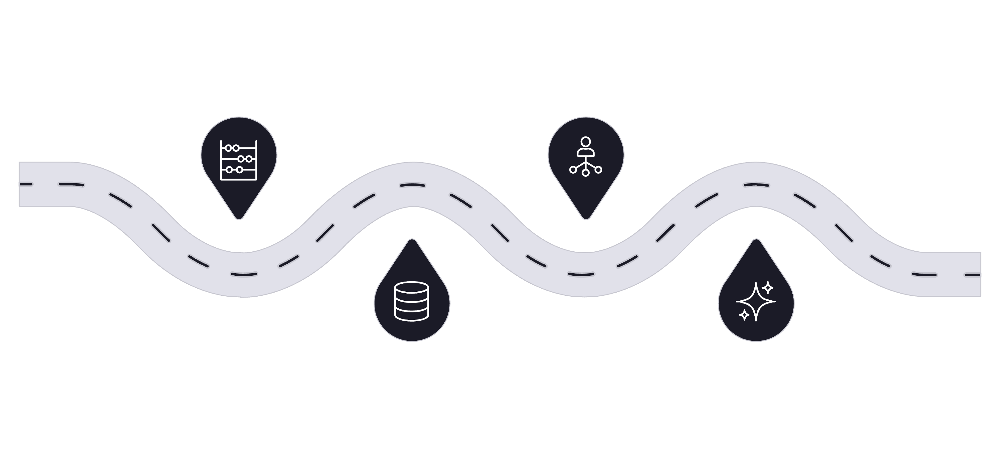

SECTION 2
A Brief History of Generative AI
Early AI
2010s
Rule-based systems and symbolic methods
Deep learning transforms perception and language
2000s
2020s
Statistical learning and data-driven models
Generative models reshape creative workflows
From simple rule-based systems to the sophisticated models of today, AI has come a long way in a relatively short time. The journey has been marked by breakthroughs that continuously redefine what machines are capable of creating.

Slide 5

SECTION 3
How Generative AI Works in the Background
Generative AI learns from vast amounts of existing data, identifying patterns and structures. When given a prompt, it iteratively predicts the next element—be it a word, a pixel, or a note—to generate new, original content. It's essentially advanced "pattern-matching at scale."
1
2
3
Data Training
Pattern Recognition
Content Generation
AI is fed massive datasets like books, images, and music to learn the world's creative rules.
It analyzes this data to understand relationships and underlying structures.
Using what it's learned, AI generates new content by predicting the next most probable element.
Interactive Exercise:
Ask participants to write a prompt for ChatGPT or DALL·E. Discuss results.

Slide 6
SECTION 3
Deep Dive: Generation Across Mediums
Text Generation
Image Generation
Code Generation
Large Language Models (LLMs) predict the next word in a sequence to create coherent text.
Diffusion models begin with noise and iteratively refine it into detailed images.
AI tools like Copilot learn from existing codebases to suggest and complete lines of code.

Slide 7
SECTION 4
Diverse Types of Generative AI
Text Generation
Image Generation
Code Generation
ChatGPT, Jasper (for writing articles, emails, creative stories)
DALL·E, MidJourney, Stable Diffusion (for creating art, designs, realistic images)
GitHub Copilot, Tabnine (for assisting developers with programming)
Music / Audio
Video / Animation
AIVA, Jukebox (for composing soundtracks, generating sound effects)
Runway ML (for creating short videos, editing footage)
Activity: Show AI-generated images, texts, or music and ask participants to guess “AI or human-made?”

Slide 8

SECTION 5
Real-Life Applications Across Industries
Education: AI tutors, essay writing, summaries
Entertainment: Music, movies, art
Marketing: Social media content, ads
Healthcare: Generate synthetic medical images for training
Software Development: Code generation and debugging
Case Study: Netflix
Netflix famously uses AI to generate customized movie thumbnails based on your viewing history and preferences, optimizing engagement for every user.

Slide 9

SECTION 6
Generative AI: Advantages and Limitations
Advantages
Limitations
Saves time and effort by automating content creation.
Enhances creativity by offering new perspectives and ideas.
Enables scalable content production across various needs.
AI hallucinations: Can generate incorrect or nonsensical outputs.
Bias in outputs: Reflects biases present in its training data.
Copyright issues: Questions around ownership of AI-generated content.
High computational cost: Requires significant processing power.
Discussion Prompt:
“Would you trust AI-generated content without checking?”

Slide 10


SECTION 8
Ethics and Future Trends
As Generative AI evolves, so do the discussions around its ethical implications and future potential. We must consider how to responsibly integrate these powerful tools into society.
Ethical Questions
Future Trends
Can AI replace human artists or writers? Who is responsible for AI-generated content?
AI as co-creators in art, music, and research. Rise of Agentic AI that can create and act.

